Slide 1
Daniel 9

Slide 2
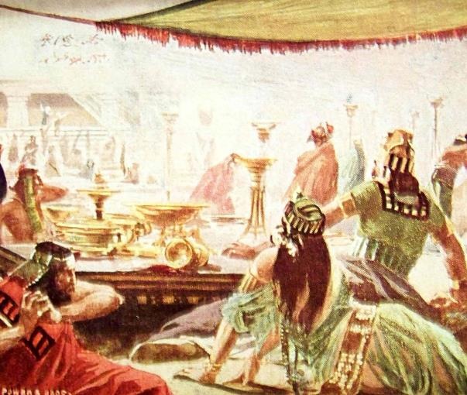
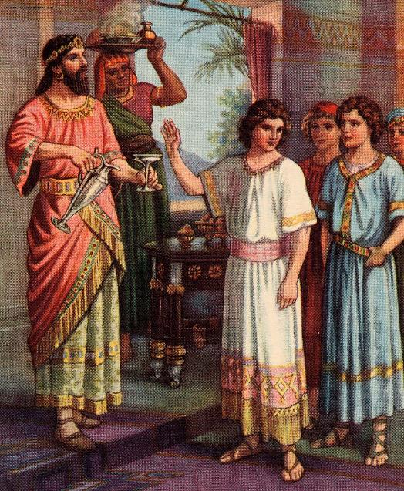
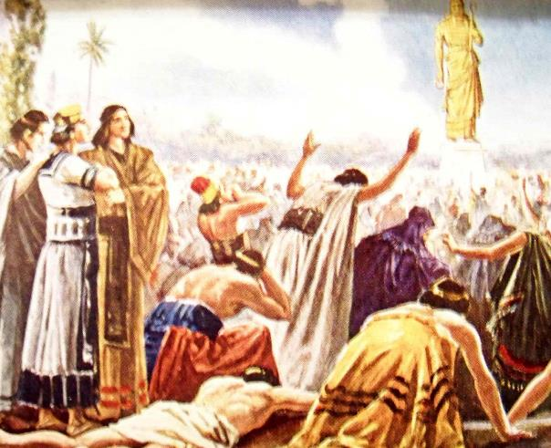
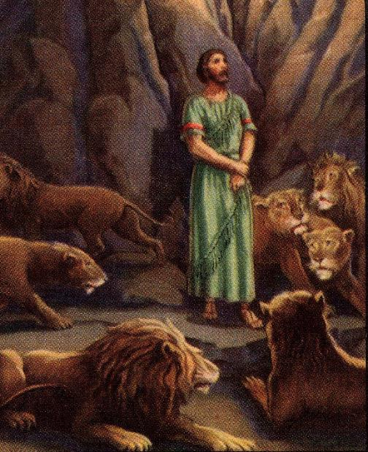
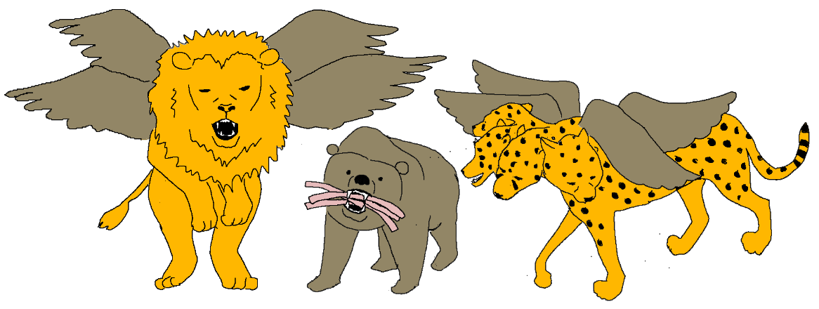
The Book of Daniel
Daniel 1 – King's food
Daniel 2 – Dream of the statue
Daniel 3 – Golden statue and fiery furnace
Daniel 4 – Dream about the tree
Daniel 5 – Writing on the wall
Daniel 6 – Lion's den
Daniel 7 – Vision of the 4 beasts
Daniel 8 – Vision of the Ram and Goat
Notes:
This is a summary of the chapters in the book of Daniel.
Now we will look at chapter 9.

Slide 3
Daniel 9:1-3_{NLT}
It was the first year of the reign of Darius the Mede, the son of Ahasuerus, who became king of the Babylonians.
During the first year of his reign, I, Daniel, learned from reading the word of the LORD, as revealed to Jeremiah the prophet, that Jerusalem must lie desolate for seventy years.
So I turned to the Lord God and pleaded with Him in prayer and fasting. I also wore rough burlap and sprinkled myself with ashes.
Notes:
Daniel 9:1-3 sets the scene
Daniel prays to God, praising God for His faithfulness and righteousness, and acknowledging that Israel had sinned and that they deserved their punishment.
As Daniel is praying, the angel Gabriel appears to him at the time of the evening sacrifice.

Slide 4
Daniel 9:24_{NLT}
A period of seventy sets of seven has been decreed for your people and your holy city to:
Finish their rebellion
To put an end to their sin,
To atone for their guilt,
To bring in everlasting righteousness,
To confirm the prophetic vision,
And to anoint the Most Holy Place.
70 x
7
For people & Holy City
Notes:
Read Daniel 9:24

Slide 5
Daniel 9:25_{NLT}
Now listen and understand!
Seven sets of seven
Plus sixty-two sets of seven will pass:
From the time the command is given to rebuild Jerusalem
Until a ruler—the Anointed One—comes.
Jerusalem will be rebuilt with streets and strong defenses, despite the perilous times.
Rebuild Jerusalem
Anointed One
62 x
7 x
7
+
7
70 x
7
For people & Holy City

Slide 6
Daniel 9:26_{NLT}
After this period of sixty-two sets of seven
The Anointed One will be killed, appearing to have accomplished nothing,
And a ruler will arise whose armies will destroy the city and the Temple.
The end will come with a flood, and war and its miseries are decreed from that time to the very end.
Rebuild Jerusalem
Anointed One
62 x
7 x
7
+
7
70 x
7
For people & Holy City

Slide 7
Daniel 9:27_{NASB}
And He (the Anointed One) will confirm a covenant with the many for one week,
But in the middle of the week He will put a stop to sacrifice and grain offering;
And on the wing of abominations will come the one who makes desolate, until a complete destruction…”
Stop sacrifices
Rebuild Jerusalem
Anointed One
62 x
7 x
7
+
7
1 week
70 x
7
For people & Holy City
Covenant
Notes:
We are going to switch to the NASB version of the Bible here because it is easier to understand.
The New Testament was originally written in Greek and has then been translated into English by various individuals and groups. When you are doing a serious Bible study, or when you find a verse that is hard to understand, it can be very helpful to look at multiple translations, remember that every verse must agree with the rest of the Bible and most importantly pray for God to help us understand the meaning of the Bible.

Slide 8
Click on the 1 week to convert to days
Click on each of the blue boxes to do the multiplication
Stop sacrifices
Rebuild Jerusalem
Anointed One
7 x
7
+
62 x
7
49
434
7
1 week
70 x
7
For people & Holy City
490
Covenant
Notes:
Each set of 7 actually refers to a week.
Click on each blue square to convert into days.

Slide 9
Ezekiel 4:1-6
…take a large clay brick and set it down in front of you. Then draw a map of the city of Jerusalem on it. Show the city under siege…
Now lie on your left side and place the sins of Israel on yourself …one day for each year of their sin.
After that, turn over and lie on your right side for 40 days—one day for each year of Judah’s sin.
Stop sacrifices
Rebuild Jerusalem
Anointed One
7
+
49
7
49
434
434
7
7
490
7
For people & Holy City
490
Covenant
Notes:
God told the prophet Ezekiel to act out a number of prophecies, and God told Ezekiel to act out 1 day for every year of the prophecy.
Bible scholars have found that the same principal, 1 day for each year, also applies to other prophecies in the Bible.

Slide 10
Click to add 49 + 434
Click to divide the last week in half
483 years after the command to rebuild Jerusalem, the Anointed One would appear.
3 ½ years later the sacrifices would stop.
3 ½ years left for the Holy City to end their rebellion and sin etc.
Stop sacrifices
Rebuild Jerusalem
Anointed One
49
+
483
434
7
3½+3½
490
For people & Holy City
Covenant

Slide 11
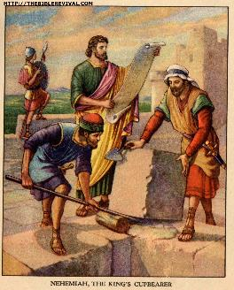
Stop sacrifices
Rebuild Jerusalem
Anointed One
+
483
7
3½+3½
490
For people & Holy City
Covenant
Ezra
457 BC
Notes:
The command to rebuild the city of Jerusalem is recorded in the book of Ezra– we will be studying Ezra’s story in 3 weeks time.

Slide 12
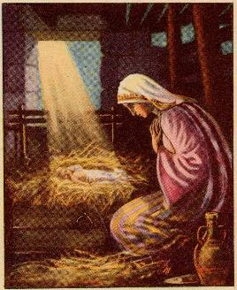
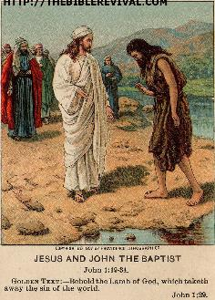
Stop sacrifices
Rebuild Jerusalem
Anointed One
+
483
7
3½+3½
490
For people & Holy City
Covenant
Jesus Birth ~4 BC
Jesus Baptism 27 AD
Ezra
457 BC
Notes:
The calendar system that we most commonly use today is called the Gregorian calendar. The years before Jesus birth are called BC meaning ‘Before Christ’ or BCE meaning ‘Before Common Era’ and count down to Jesus' birth and the years after are called AD, which is Latin for ‘the year of our Lord’ or CE for ‘Common Era’ and count up from then till now.
If you go forward 483 years from 457 BC you come to 27 AD (Note: 457 + 27 – 1 (because there is no year 0) = 483)
Jesus was baptized 27 AD. That is when He began His official ministry on earth as the Messiah or Anointed One.
Numbers 4 tells us that the Priests began their ministry in the temple at the age of 30 so we believe that Jesus was probably 30 when He started His ministry.
Therefore Jesus birth would have actually been around 4BC

Slide 13
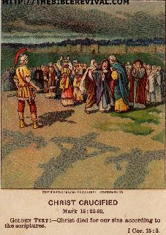
Stop sacrifices
Rebuild Jerusalem
Anointed One
+
483
7
3½+3½
490
For people & Holy City
Covenant
Jesus Birth ~4 BC
Jesus Baptism 27 AD
Ezra
457 BC
Jesus Death 30½ AD
Notes:
When Jesus died the curtain in the temple that separated the Most Holy place from the Holy Place was torn open to show the earthly Sanctuary and its' sacrifices were no longer needed. (Matthew 15:37) – Jesus was the final sacrifice.

Slide 14
Stop sacrifices
Rebuild Jerusalem
Anointed One
+
483
7
3½+3½
490
For people & Holy City
Covenant
Jesus Birth ~4 BC
Jesus Baptism 27 AD
Ezra
457 BC
Jesus Death 30½ AD
Stoning of Stephen 34 AD
Notes:
During His ministry, Jesus sometimes sent His followers out to preach in other towns but He told them in Matthew 10:5 to only go to the Jewish towns.
It was after the stoning of Stephen, when the followers of Jesus fled from Jerusalem that the Gospel was taken other nations.
This was the end of the time that the Jews had specifically been given, but unfortunately, the leaders of the day chose NOT to put an end to their rebellion and sin.

Slide 15
Stop sacrifices
Rebuild Jerusalem
Anointed One
+
483
7
3½+3½
490
For people & Holy City
Covenant
Jesus Birth ~4 BC
Jesus Baptism 27 AD
Ezra
457 BC
Jesus Death 30½ AD
Stoning of Stephen 34 AD
Notes:
Remember that when Daniel was given this prophecy, it was a future prophecy. In fact, Daniel didn’t live to see it happen. But for us, we can look back and see exactly how the prophecy was fulfilled. It helps us to know that God is in control. And if God says it will happen, then it will.

Slide 16
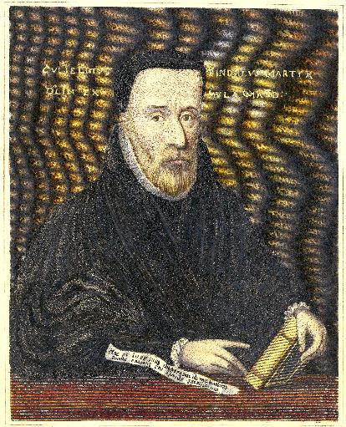
William Tyndale
William Tyndale found God while studying a Greek Bible and became a strong supporter of the scriptures. He became a travelling preacher but was frustrated when the priests would undo his work after he had left; he realised if the people had their own Bibles they could study and test the truths for themselves.
One day someone argued with him, "We were better to be without God's laws than the Pope's." Tyndale replied: "I defy the pope and all his laws; and if God spare my life, ere many years I will cause a boy that driveth the plough to know more of the Scripture than you do." (GC refers: --Anderson, Annals of the English Bible, page 19.)

Slide 17
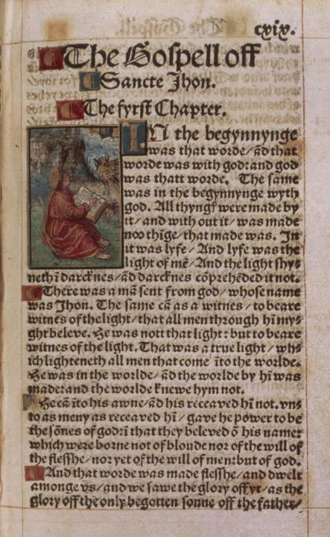
William Tyndale
There were no printing presses when John Wycliffe translated the first English Bible from Latin almost 150 years earlier - it was copied by hand. Now Tyndale determined to translate the Greek Bible into the English of the common people so even the poorest could understand. He was soon forced to flee and seek shelter in Germany, where more than once, he had to move, but finally the Bibles were printed and smuggled into England.
One time, the Bishop of Durham, trying to stop the spread of Bibles, by purchasing all the Bible for sale; what he didn't realized was the money he paid enabled Tyndale to print even more Bibles. When Tyndale was arrested and ordered to tell who paid for the printing, he said the Bishop helped most!

Slide 18
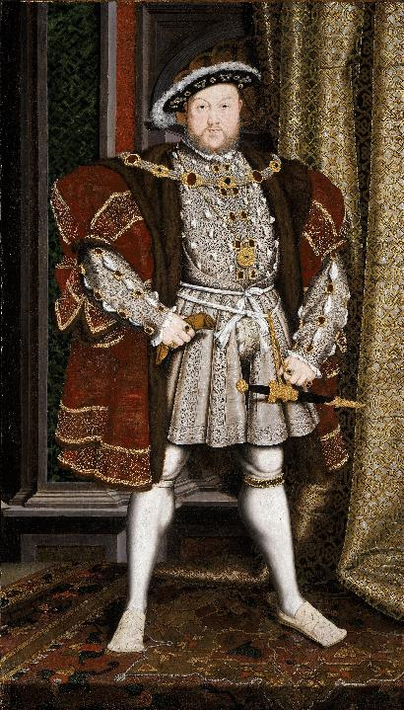
Church of England
Tyndale became a martyr, but the influence of his Bibles could not be stopped. It was around this time that the Church of England was created as the countries official church and while many of the doctrines of Rome were renounced, much of the style of worship was kept and the king of England was declared the head of the church rather than the Pope.
Religious freedom was still forbidden and the principal salvation through Jesus rather than by works was gradually lost again.

Slide 19
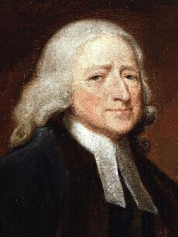
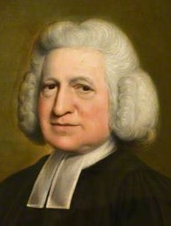
The Wesley Brothers
John and Charles Wesley were born in the early 1700's; they found the truth when they experienced a violent storm on a ship and saw the peace of a group of Moravians – a church founded on the teachings of John Huss.
For years they had been working to earn God's salvation; now, after much study, they realised that they had salvation through Jesus as a gift of God.
They spent the rest of their lives sharing this truth with the people of England.

Slide 20
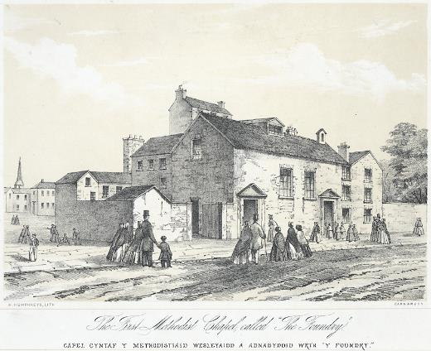
The Methodists
The Wesley brothers’ followers became known as the Methodists. The life of the Methodists was not easy as they were often persecuted and beaten, and their property was damaged and stolen. John Wesley wrote that God saved him from death several times: One time, a mob tried to push him over and trample him, but he did not fall; someone in the mob tried to hit him over the head with a large stick, but he kept missing. At other times he was punched or hit with stones, but God worked miracles and he felt no pain at all!

